Slide 1
ACDV B80
UNIT #1
Diana Cason
Bakersfield College

Slide 2
Habits of Mind

Slide 3

Habits of Mind
Who decides your final grade for this class?
Turn to page 2 of the syllabus for this class.
In groups, come up with a list of obstacles that college students often face (both academic and personal).
Choose two of those obstacles, and discuss ways that students can respond proactively, practicing habits of mind.

Slide 4


Are you ready to take notes?
Take out a sheet of notebook paper.
Put your first and last name in the upper left-hand corner.
Give your notes this title: Unit #1 Notes
You will continue to add to your notes at each of the next several class meetings. Add the date each time.
Take notes each time you see this:

Slide 5

Note-Taking Should be Active—not passive!
When should you write something down in class?
What is the goal of note-taking?
  Goal is not to make an exact copy of the reading/lecture
  Helps identify key points
  Aids memory
Don’t copy everything you see word-for-word
  PARAPHRASE! (Express ideas in your own words.)
  Focus on key words.
  Use abbreviations and symbols (See pg. 10 HP.)
  Don’t write in complete sentences.
Organize your notes.
  Include the date and a title.
  Use headings/subheadings.
  Use bullet points.
  Separate topics with blank space.
Note-Taking Scoring Checklist (See pg. 9 HP)

Slide 6

SQ3R
Are You Ready to Take notes?

Slide 7

What is SQ3R?
Survey
Question
Read
Recite
Review
A five step technique for reading and studying textbook material

Slide 8
Why use SQ3R?
Maximizes your reading and saves time
Helps you determine what you need to know
Increases comprehension
Helps with recall of material and test-preparation

Slide 9
Survey
Simply look over (“preview”) the chapter
  Chapter title, headings, and subheadings
  Illustrations and their captions
  Key terms and their definitions
  Review questions
  Chapter objectives or goals
  Introduction
  Chapter summary

Slide 10
Question
Turn the title, headings and subheadings into open-ended (reporter) questions.
  What
  Why
  How
Creates interest
Helps maintain focus

Slide 11
Read Actively
Look for answers to questions.
Annotate (mark) the text. (Turn to pg. 27 HP.)
  Write thoughts in margins
  Highlight
  Underline
Reread parts that are unclear.

Slide 12
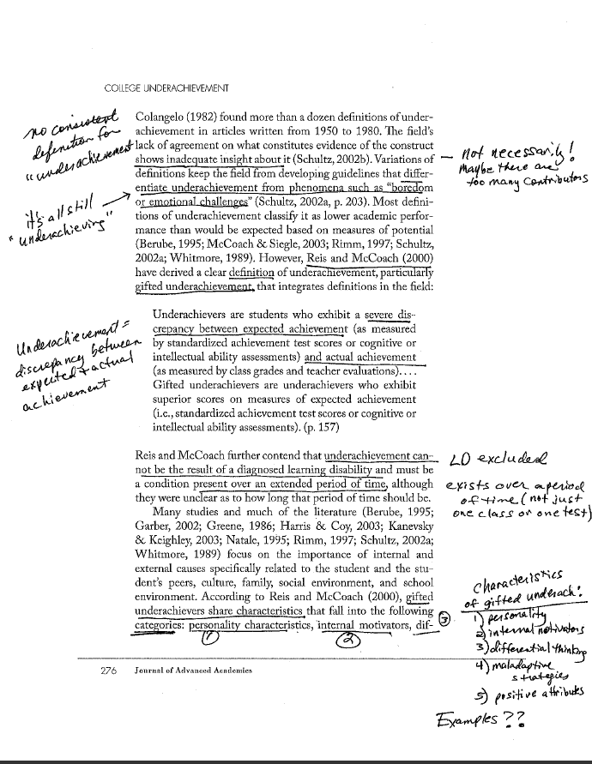
Example of annotating

Slide 13
Recite
  Put the information in your own words.
  Write a summary.
  Explain the material to someone else or discuss it with classmates.
  Write notes (in book or notebook)/Cornell Notes.
  Create flashcards, concept/mind maps, or outlines.

Slide 14
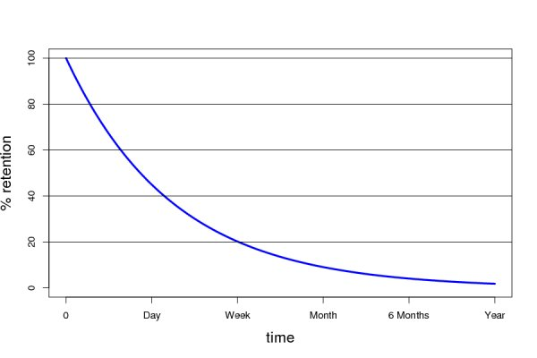
Review
Research shows that as much as 40-50% of what we read is forgotten after 15 minutes.
Regular, ongoing review aids with retention.

Slide 15
Review
Review your notes as often as possible:
  immediately after you’ve taken them
  before going to class
  before reading the next chapter
  before tests
Write down any questions that you still have about the material.

Slide 16
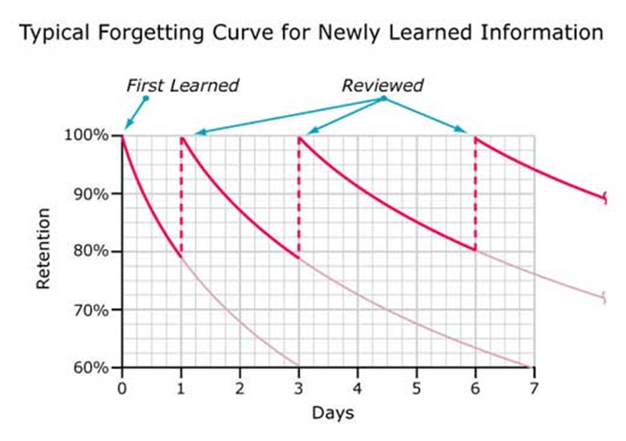
The Forgetting Curve

Slide 17
Review Quiz
Which SQ3R step should take the longest?
What is an open-ended question?
What is one method of reciting information?
For which subject does SQ3R work best?

Slide 18
LEARNING STYLES

Slide 19

What are learning styles?
Most people have a dominant learning style.
Research shows that students earn higher grades when they change their study habits to suit their learning style
Each learning style uses a different part of the brain.
By involving more parts of the brain, we remember more of what we’re trying to learn.

Slide 20
V.A.R.K.
Questionnaire

Slide 21
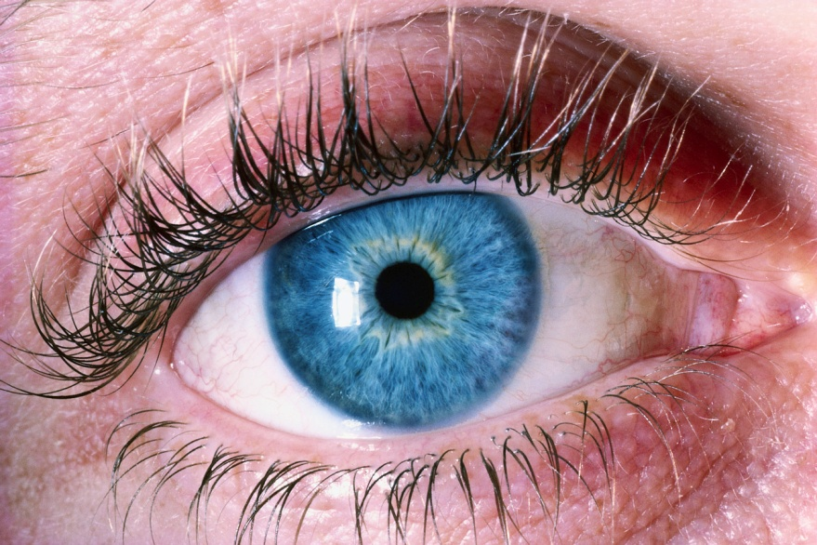
Visual Learners
Respond to color
May be artistic or enjoy looking at art
Like things to look neat
Good at using maps and rarely get lost
Dress well
Never forget a face

Slide 22

Aural Learners
May sing well or play an instrument
Love to listen to music
Good listeners
Not afraid to talk in front of a group
Call their friends and family members often
Never forget a name

Slide 23

Reading And Writing Learners
Avid readers
May keep a diary or journal
Prefer sending text, letter, or email rather than making a phone call
Good at spelling
Like learning and using new words

Slide 24
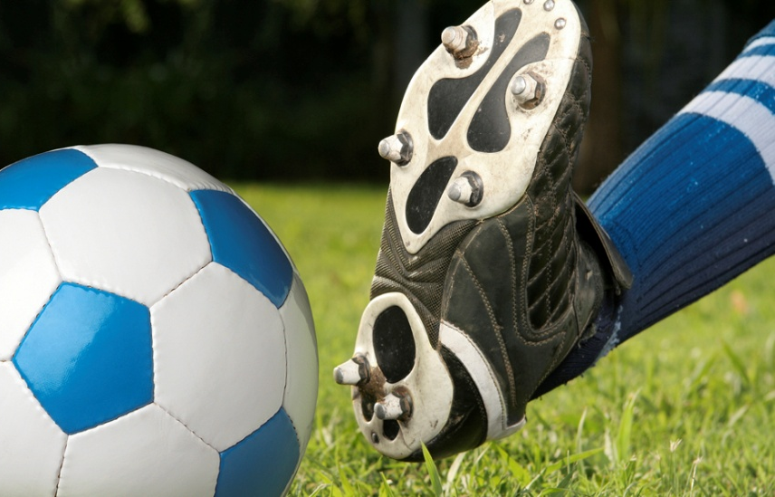
Kinesthetic Learners
May be athletic
Use body language to communicate
May enjoy roller coasters, dancing, martial arts or other physical activities
Have trouble sitting still for long periods of time

Slide 25

Which Study Strategies Are Best Suited for Your Learning Style? (SEE PG. 3 HP.)

Slide 26

Email Etiquette
Are you ready to take notes?

Slide 27

Email Communication
On college campuses and in the work place, email is the primary form of communication.
Following email etiquette helps to ensure that messages are communicated successfully.

Slide 28

1. Be brief and to the point
You are not writing a novel!
Professors and other professionals receive several dozen emails every day.
Stick to key points.

Slide 29
2. Include an appropriate subject line.
Write a brief subject line that indicates what your email is about.
  HIST 17B Tues. & Thurs. 1:00
  Class absence
  Research paper
  Administrative Assistant Position
Emails without subject lines or subject lines like “hi” or “hey” may end up in the receiver’s spam folder.

Slide 30

3. Include an appropriate greeting/closing
“Hi,” “Hello,” “Dear,” and “Good morning” are all appropriate greetings for a professional email.
Include the person’s title (Mr./Ms./Mrs./Dr.) if appropriate.
Spell his/her name correctly.
Include your full name and class information.
“Sincerely” and “Thank you” are appropriate closings.

Slide 31

4. Use standard English
No texting slang (An email is not a text message!)
Complete sentences
Correct grammar, spelling, and punctuation (Proofread before sending.)
DO NOT WRITE IN ALL CAPS (The recipient may feel as though they are being shouted at.)

Slide 32

5. Keep it formal and professional
Be polite (Use words like “please” and “thank you.”)
Don’t include anything too personal.
Allow at least 24-48 hours for a reply.

Slide 33

Practice
Read the email from Vanessa to her professor.
Keeping in mind the guidelines we just reviewed, discuss in groups what should she have done differently. Have one of your group members keep a list with your ideas.

Slide 34
From: prettygurlkat@gmail.com
To: diana.cason@bakersfieldcollege.edu
Date: 12/10/2015
Subject: class
hey miss Cason!! this is vanessa from ur class… im sorry i missed class yesterday. my bf flushed my car keys down the toilet cuz he was jealous lol an i couldnt get their. i know we had to turn in our project and take the exam. is it gonna hurt my grade? if u want I could come make it up.. i will turn in my project as soon as i can. also i wanna know if there is any hw cuz I work 15 hours a week an dont have time 2 get 2 a computer 2 look it up. um…well let me no. I’m a really good student & i want an A in ur class. EMAIL ME BACK ASAP!!

Slide 35
Plagiarism
Are you ready to take notes?

Slide 36
PLAGIARISM TRUE OR FALSE
If I paraphrase something (put it in my own words), I do not need to give credit for it.
Copying only one sentence from someone else’s work is not considered plagiarism.
I do not need to give credit for online sources because everything on the internet is considered “public domain.”
I do not need to give credit for facts, like “The earth is the third planet from the sun.”
Professors have no way of knowing if a student did not write all of his/her essay.
If I wrote a paper for my ACDV B80 class, I can reuse it in my English 60 class because it’s my work.
If I just forgot to include quotation marks and a citation, but I meant to, this does not count as plagiarism.

Slide 37
What is Plagiarism?
Plagiarism is all of the following:
  turning in someone else's work and not giving credit
  copying words or ideas from someone else without giving credit even if it’s limited to just a few words in your paper
  changing the wording but copying someone else’s sentence structure without giving credit
  forgetting to include quotation marks
  copying so many words or ideas from a source that it makes up most of your paper

Slide 38

Why Do Students Plagiarize?
In groups, discuss the reasons why students might plagiarize.

Slide 39
HOW IS IT POSSIBLE TO STEAL SOMEONE’s IDEAS?
Michelle Obama: “And Barack and I were raised with so many of the same values: that you work hard for what you want in life; that your word is your bond and you do what you say you're going to do; that you treat people with dignity and respect, even if you don't know them, and even if you don't agree with them.
And Barack and I set out to build lives guided by these values, and to pass them on to the next generation. Because we want our children — and all children in this nation — to know that the only limit to the height of your achievements is the reach of your dreams and your willingness to work for them."
Melania Trump: “From a young age, my parents impressed on me the values that you work hard for what you want in life, that your word is your bond and you do what you say and keep your promise, that you treat people with respect.
They taught and showed me values and morals in their daily lives. That is a lesson that I continue to pass along to our son. And we need to pass those lessons on to the many generations to follow. Because we want our children in this nation to know that the only limit to your achievements is the strength of your dreams and your willingness to work for them.”

Slide 40
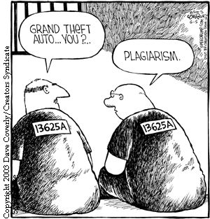
What are the Consequences at BC?
Zero points on an assignment
Failing grade in the class (if assignment is sufficiently weighted)
Referral to the Dean of Students
These penalties also apply to students who help other students cheat or plagiarize.

Slide 41
How Can Plagiarism Be avoided?
“Cite” (give credit for) all ideas that aren’t yours.
  In-text citations
  Works cited page
Use quotation marks when copying someone else’s wording exactly.
Use your own sentence structure when paraphrasing (rewording) someone else’s ideas.
If information is common knowledge, no citation is needed.

Slide 42
CORNELL NOTES

Slide 43
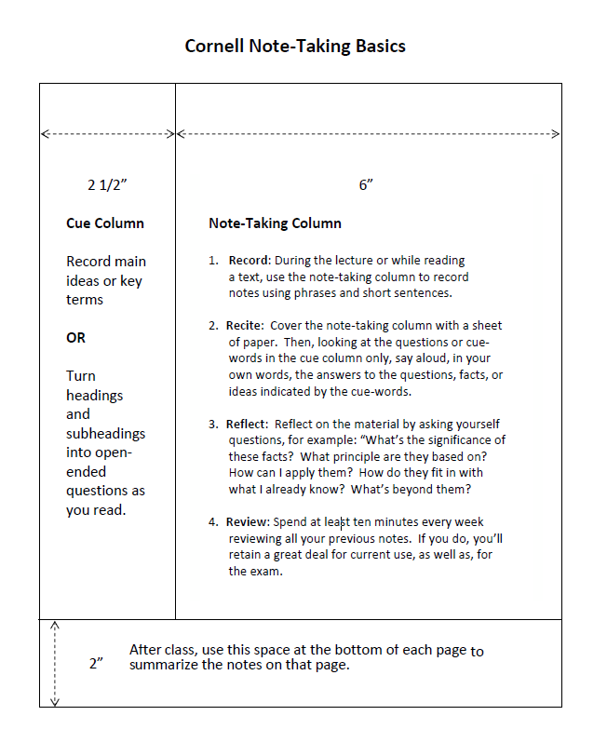
The Basics (See PG. 11-12 HP.)

Slide 44
Paragraph Structure
Ready to take Cornell notes?

Slide 45
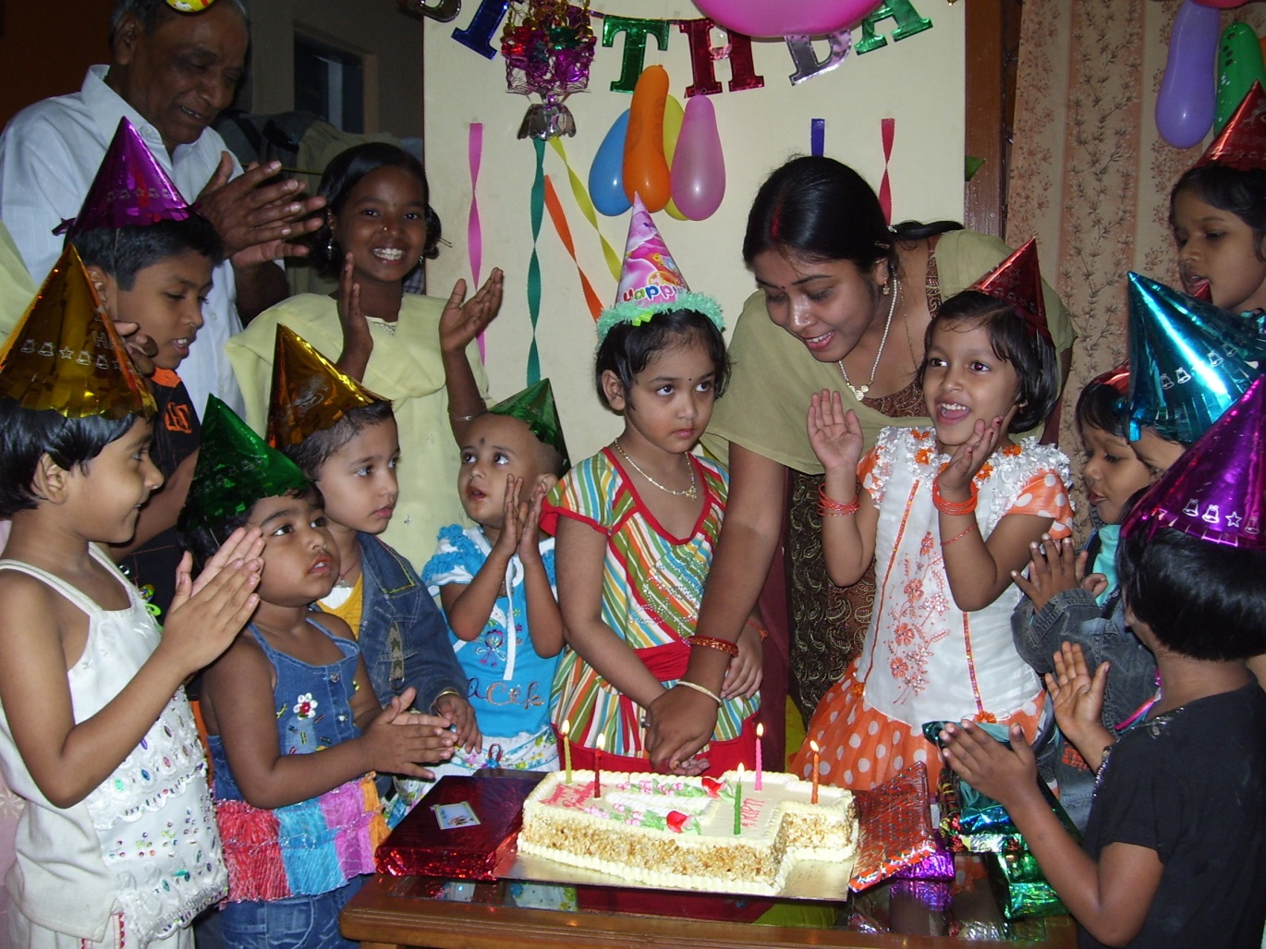
In a couple words, what does this photo depict?
Now, what details do you notice?

Slide 46

What is the paragraph about?
Topic = the general subject matter
Main Idea = the point the author wants to make about the topic (expressed in a topic sentence)
  For example: Poor grades in college can have various causes.
“Umbrella” Concept
Causes of Poor
Grades in College
relationship
trouble
financial
problems
bad study habits

Slide 47
What support does the author give?
Supporting Details = Evidence, explanation, or examples used to support the main idea/topic sentence
Supporting details are often introduced by transitions (first, also, next, finally, etc.) (See pg. 77 HP.)
Main ideas are more GENERAL than supporting details, which are SPECIFIC
  soup, water, liquid, coffee
  cotton, fabric, silk, wool
  Rock, R&B, country, music

Slide 48
Putting it all together
Poor grades in college can have various causes. For one thing, students may have financial problems. If they need to work long hours to make money, they will have little study time. Another cause of poor grades may be trouble with relationships. A student may be unhappy over family problems, a breakup, or lack of friends. That unhappiness can harm schoolwork. A final cause of poor grades may be bad study habits. Some students have never learned how to take good notes in class, manage their time effectively, or study a textbook. Without such study skills, their grades are likely to suffer.
Adapted from Ten Steps to Building College Reading Skills, John Langan, 5th Edition

