Slide 1

Aristotle’s
Modes of Persuasion
Diana Jackson
Bakersfield College

Slide 2
Who was Aristotle?
Greek philosopher and scientist
384-322 B.C.
Made notable contributions to reason and logic
Suggested that there are three modes of persuasion: logos, ethos, and pathos

Slide 3

What is logos?
Logical appeal
Relies heavily on facts, figures, statistics, definitions and academic or theoretical language
Especially effective in persuading a highly educated or skeptical audience

Slide 4

An Example of Logos
American homes and their energy consumption account for nearly 40 percent of U.S. emissions, 626 million metric tons of carbon in 2005 alone. But 33 simple actions—ranging from improving the insulation to carpooling—could cut those annual carbon emissions by 123 million metric tons.

Slide 5

What is ethos?
Appeal to authority
Speaker asserts his or her competence or expertise on the subject
Speaker relies on his or her character, credentials, reliability or reputation
Requires appropriate vocabulary and tone, as well as correct grammar

Slide 6

An Example of Ethos
ExxonMobil is a leader in the development and use of component technologies essential for carbon capture and storage (CCS), which we have focused on in our oil and gas operations for many years.

Slide 7
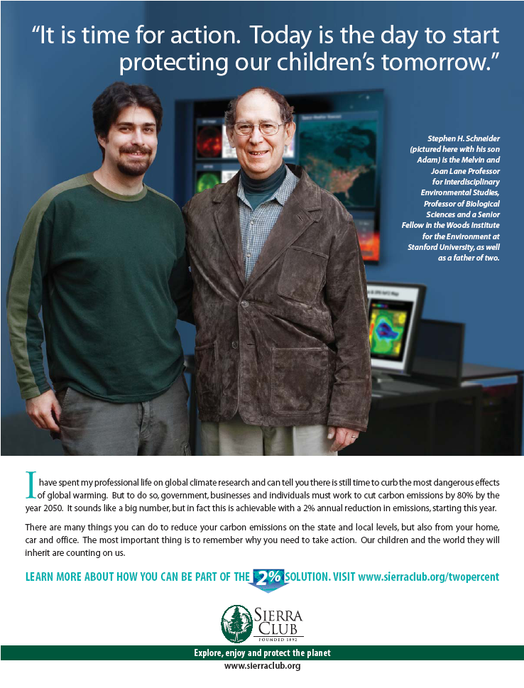
An Example of Ethos

Slide 8

What is pathos?
Emotional appeal
Attempts to evoke an emotional response from the audience
May appeal to the audience’s sense of justice or morality
Relies on figurative language, vivid description or emotional narrative

Slide 9


An Example of Pathos

Slide 10
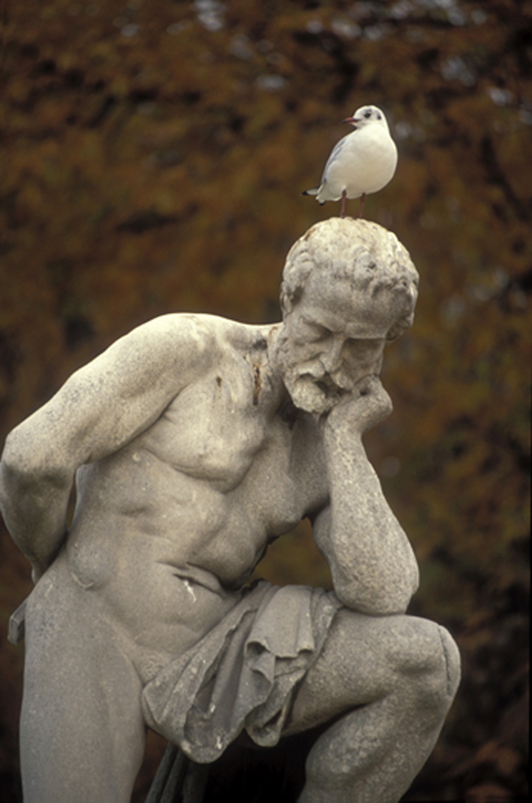

Review
Logos
Pathos
Ethos

Slide 11

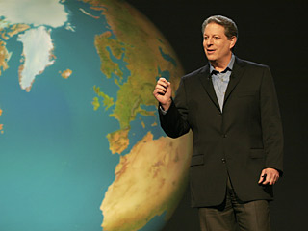
An Inconvenient Truth Trailer
http://www.youtube.com/watch?v=wnjx6KETmi4

Slide 12
References
Biello, David. “Climate Change Begins at Home: Small Steps to Cut Greenhouse Emissions Can Lead to Big Results.” Scientific American. Scientific American. 2Oct. 2009. Web. 27 Oct. 2009.
“Carbon Capture and Storage.” Exxon Mobil. Exxon Mobil Corporation. 2009. Web. 27 Oct. 2009.

Slide 13

The End

